Slide 1
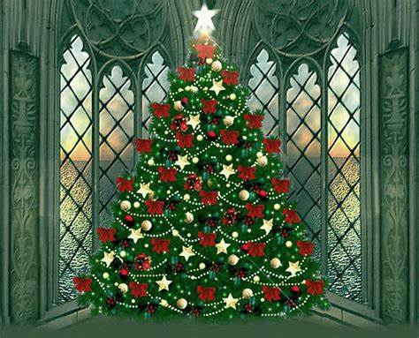
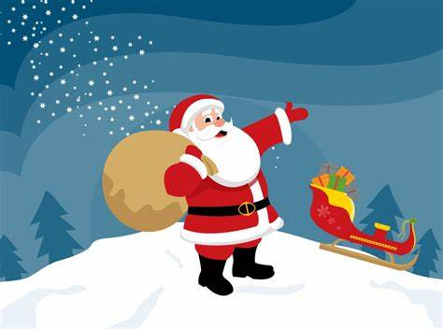
Santa Run
lADIes and gentlemen, we are holding a charity event at the center of our town. It will take place on the 24/12/2022. the tickets are 12$ per adult and 6$ per child. These are the following activities :
Santa run
Talk to santa
Santa theme park
We hope to see you there!!!
Names:anna and Anastasia
School:3rd junior high school
Date:17/12/2022

