Slide 1
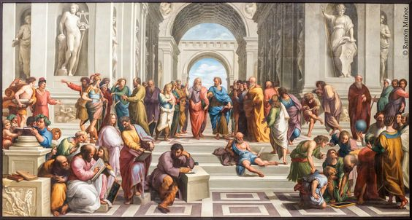
Ancient History Quiz

Slide 2
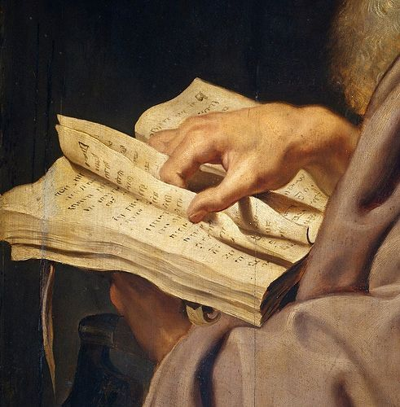
The content
The Trojan War
Alexander the Great
The Renaissance

Slide 3
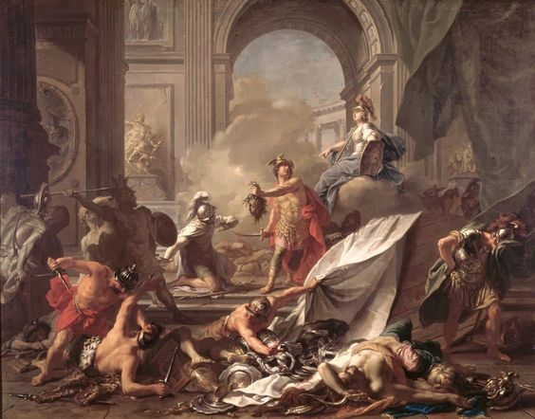
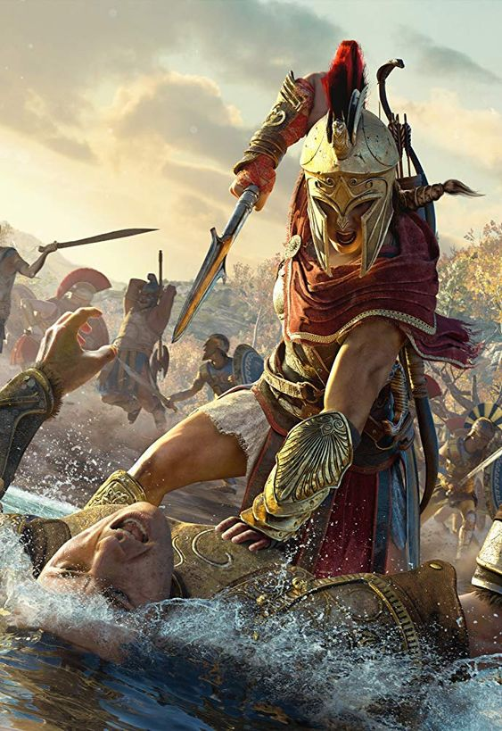
The Trojan War
Troy withstood a Greek siege for how many years?
10
9
12
Which god guided Paris’s arrow to strike Achilles’ only vulnerable point, his heel, and eventually kill him?
Ares
Apollo
What is the name of the king of Sparta, whose wife, Helen, fled Sparta with the son of the king of Troy?
Agamemnon
Menelaus
Who was Troy’s finest warrior, who was killed by Achilles?
Hector
Paris

Slide 4
The Trojan War
Troy withstood a Greek siege for how many years?
10
9
12
Which god guided Paris’s arrow to strike Achilles’ only vulnerable point, his heel, and eventually kill him?
Ares
Apollo
What is the name of the king of Sparta, whose wife, Helen, fled Sparta with the son of the king of Troy?
Agamemnon
Menelaus
Who was Troy’s finest warrior, who was killed by Achilles?
Hector
Paris

Slide 5
The Trojan War
Troy withstood a Greek siege for how many years?
10
9
12
Which god guided Paris’s arrow to strike Achilles’ only vulnerable point, his heel, and eventually kill him?
Ares
Apollo
What is the name of the king of Sparta, whose wife, Helen, fled Sparta with the son of the king of Troy?
Agamemnon
Menelaus
Who was Troy’s finest warrior, who was killed by Achilles?
Hector
Paris

Slide 6
The Trojan War
Troy withstood a Greek siege for how many years?
10
9
12
Which god guided Paris’s arrow to strike Achilles’ only vulnerable point, his heel, and eventually kill him?
Ares
Apollo
What is the name of the king of Sparta, whose wife, Helen, fled Sparta with the son of the king of Troy?
Agamemnon
Menelaus
Who was Troy’s finest warrior, who was killed by Achilles?
Hector
Paris

Slide 7
The Trojan War
Troy withstood a Greek siege for how many years?
10
9
12
Which god guided Paris’s arrow to strike Achilles’ only vulnerable point, his heel, and eventually kill him?
Ares
Apollo
What is the name of the king of Sparta, whose wife, Helen, fled Sparta with the son of the king of Troy?
Agamemnon
Menelaus
Who was Troy’s finest warrior, who was killed by Achilles?
Hector
Paris

Slide 8
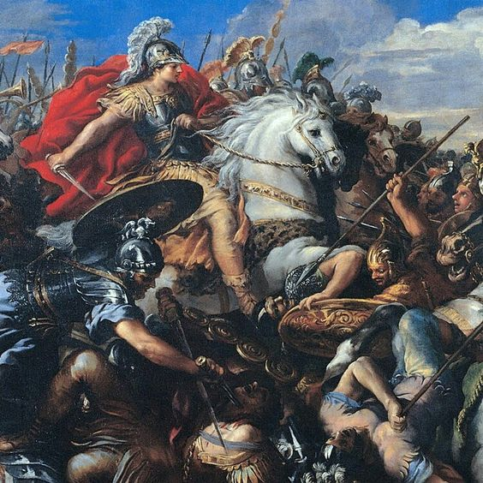
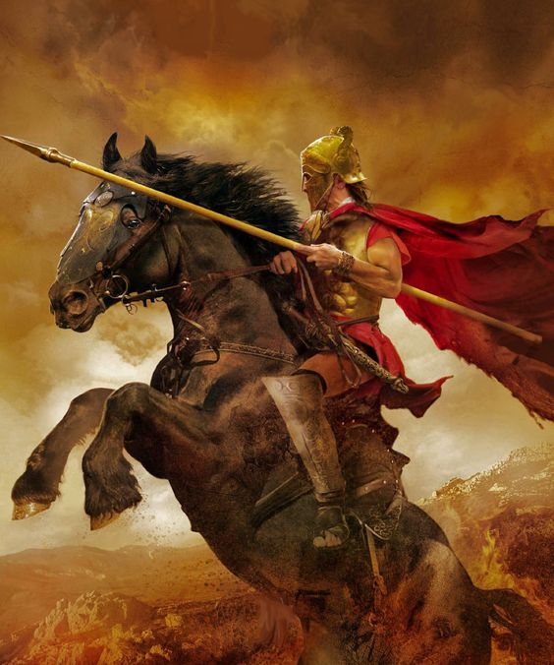
Alexander the Great
Alexander the Great was initially the king of:
Macedon
Persia
Which famous figure tutored Alexander when he was a child?
Aristotle
Socrates
Who was Alexander's father?
Phillip II
Darius III
According to legend, what did Alexander's mother dream of before his birth?
Dying
Being struck by a thunder

Slide 9
Alexander the Great
Alexander the Great was initially the king of:
Macedon
Persia
Which famous figure tutored Alexander when he was a child?
Aristotle
Socrates
Who was Alexander's father?
Phillip II
Darius III
According to legend, what did Alexander's mother dream of before his birth?
Dying
Being struck by a thunder

Slide 10
Alexander the Great
Alexander the Great was initially the king of:
Macedon
Persia
Which famous figure tutored Alexander when he was a child?
Aristotle
Socrates
Who was Alexander's father?
Phillip II
Darius III
According to legend, what did Alexander's mother dream of before his birth?
Dying
Being struck by a thunder

Slide 11
Alexander the Great
Alexander the Great was initially the king of:
Macedon
Persia
Which famous figure tutored Alexander when he was a child?
Aristotle
Socrates
Who was Alexander's father?
Phillip II
Darius III
According to legend, what did Alexander's mother dream of before his birth?
Dying
Being struck by a thunder

Slide 12
Alexander the Great
Alexander the Great was initially the king of:
Macedon
Persia
Which famous figure tutored Alexander when he was a child?
Aristotle
Socrates
Who was Alexander's father?
Phillip II
Darius III
According to legend, what did Alexander's mother dream of before his birth?
Dying
Being struck by a thunder

Slide 13
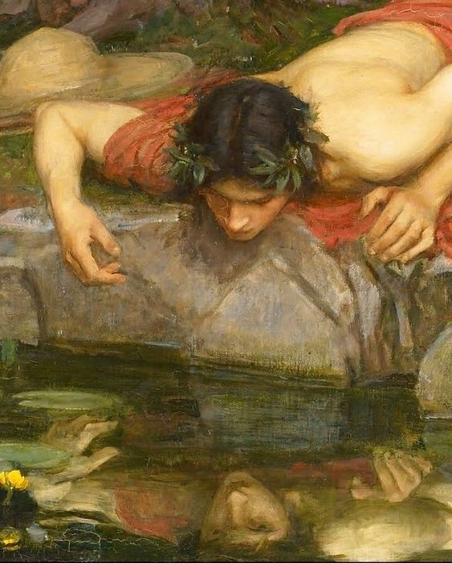
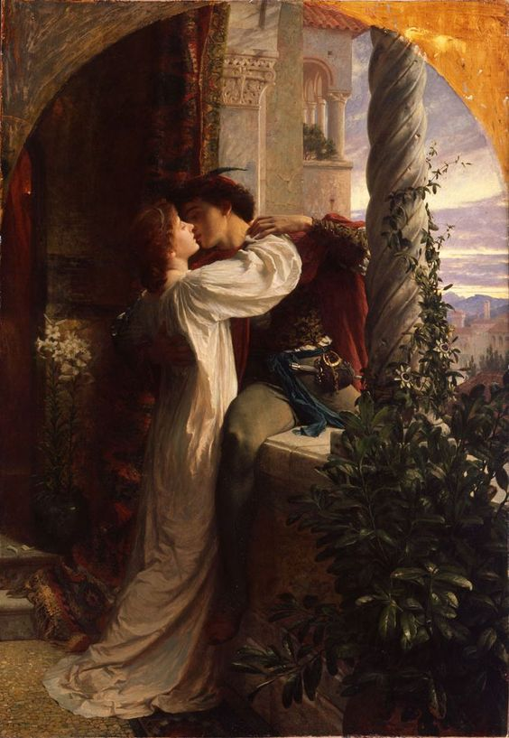
The Renaissance
What is another term that is sometimes used in reference to the Renaissance?
The New World
Dark Ages
What is Galileo known for?
His art
work
His work in Science and Astronomy
What was revolutionary during the Renaissance?
Gutenberg's printing press
The Church
What country was at the center of world culture?
France
Italy
Who painted the ceiling of the Sistine Chapel?
Leonardo Da Vinci
Michelangelo

Slide 14
The Renaissance
What is another term that is sometimes used in reference to the Renaissance?
The New World
Dark Ages
What is Galileo known for?
His art
work
His work in Science and Astronomy
What was revolutionary during the Renaissance?
Gutenberg's printing press
The Church
What country was at the center of world culture?
France
Italy
Who painted the ceiling of the Sistine Chapel?
Leonardo Da Vinci
Michelangelo

Slide 15
The Renaissance
What is another term that is sometimes used in reference to the Renaissance?
The New World
Dark Ages
What is Galileo known for?
His art
work
His work in Science and Astronomy
What was revolutionary during the Renaissance?
Gutenberg's printing press
The Church
What country was at the center of world culture?
France
Italy
Who painted the ceiling of the Sistine Chapel?
Leonardo Da Vinci
Michelangelo

Slide 16
The Renaissance
What is another term that is sometimes used in reference to the Renaissance?
The New World
Dark Ages
What is Galileo known for?
His art
work
His work in Science and Astronomy
What was revolutionary during the Renaissance?
Gutenberg's printing press
The Church
What country was at the center of world culture?
France
Italy
Who painted the ceiling of the Sistine Chapel?
Leonardo Da Vinci
Michelangelo

Slide 17
The Renaissance
What is another term that is sometimes used in reference to the Renaissance?
The New World
Dark Ages
What is Galileo known for?
His art
work
His work in Science and Astronomy
What was revolutionary during the Renaissance?
Gutenberg's printing press
The Church
What country was at the center of world culture?
France
Italy
Who painted the ceiling of the Sistine Chapel?
Leonardo Da Vinci
Michelangelo

Slide 18
The Renaissance
What is another term that is sometimes used in reference to the Renaissance?
The New World
Dark Ages
What is Galileo known for?
His art
work
His work in Science and Astronomy
What was revolutionary during the Renaissance?
Gutenberg's printing press
The Church
What country was at the center of world culture?
France
Italy
Who painted the ceiling of the Sistine Chapel?
Leonardo Da Vinci
Michelangelo

Slide 19
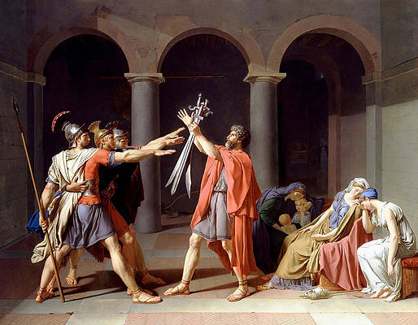
Thank you for your consideration!!!

