Slide 1
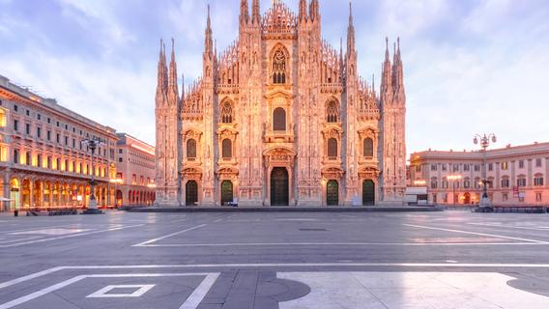
Duomo di Milano
Duomo di Milano is one of the cathedral churches in Milan (Lombardy, Italy). Dedicated to the Nativity of Saint Mary (Santa Maria Nascente), it is the seat of the Archbishop of Milan.

Slide 2
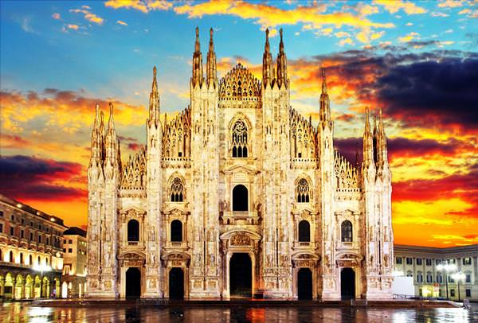
History
The Cathedral took nearly six centuries to complete (1386 – 1965). It is the largest church in the Italian Republic, possibly the second largest in Europe and the Third in the world. Work progressed rapidly and when Jan Galeazzo died (1402) almost half of the cathedral was completed. In 1577, Carlo Borromeo consecrated the building as a new church.

Slide 3
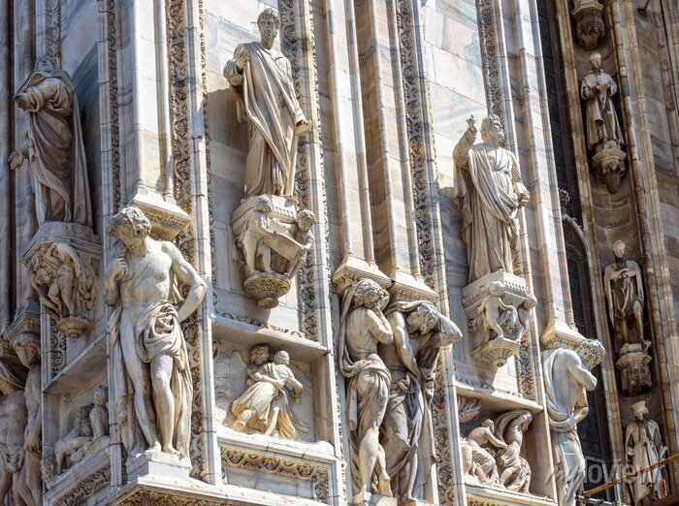
In 1762 one of the main features of the church was erected, the spear of Madonna, 108.5 meters high. The spit was designed by Carlo Pellicani and at the top is the statue of Madonna, by Giuseppe Perezzo. On May 20, 1805, Napoleon I Bonaparte, who was preparing to be crowned King of Italy, ordered the façade completed by Pelicani.

Slide 4
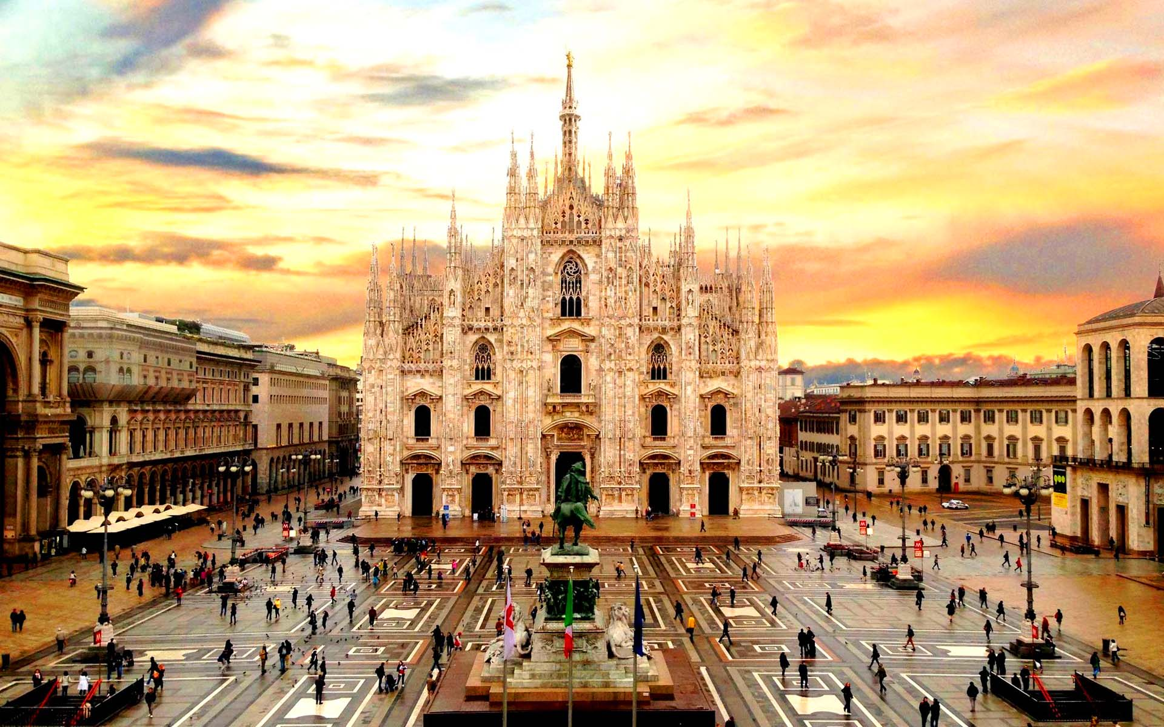
Excited, he confirmed that the cost of construction would be covered by the French treasury, which would reimburse the construction company for selling its property. Although the compensation was not paid, the facade was completed in just seven years. Pelican followed an older design, adding some neo-Gothic details to the upper windows. As a token of thanksgiving, a statue of Napoleon stands on top of a spit. Napoleon was crowned King of Italy at the Duomo.

Slide 5
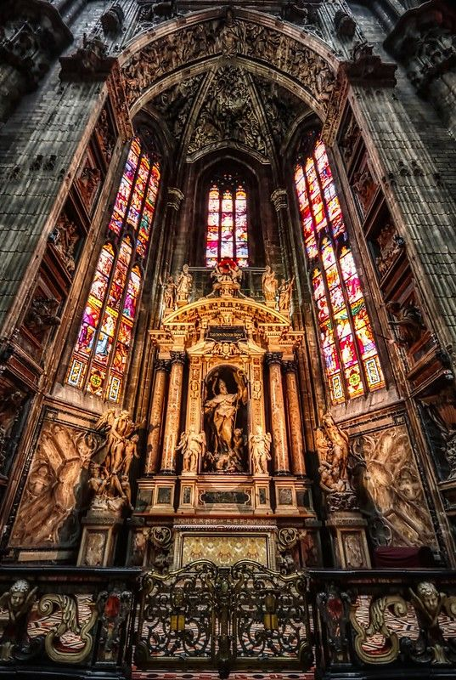
Architecture
The plan of the temple consists of an aisle with four side corridors, the transverse aisle and then the choir and the sanctuary. The height of the aisle is 45 meters, the highest in a Gothic church that has been completed. The four large aisles of the temple, which are separated by 40 columns, are reflected in the gates of the facade. The transverse aisles also have side corridors. The columns of the aisles are 24.5 meters high and the windows in the sanctuary are 20.7 by 8.5 meters. The supporting structure of the church is made of bricks and its exterior is covered with marble from the quarries of Cantolia.
Iliana Amiadi, Katerina Aggelakopoulou, Gaganhs Vangelis

