Slide 1
WELCOME TO THE BRIDGE OF ARTA

Slide 2
1881 THE BRIDGE OF ARTA -PHOTOGRAPHIC ARCHIVE FROM THE NATIONAL HISTORICAL MUSEUΜ

Slide 3
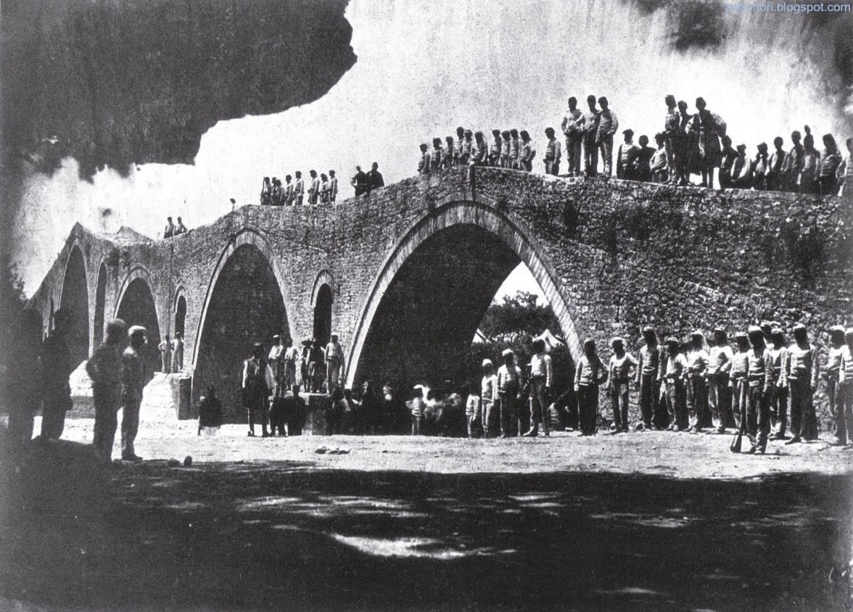
1897 THE BRIDGE OF ARTA -PHOTOGRAPHIC ARCHIVE FROM THE NATIONAL HISTORICAL MUSEUΜ

Slide 4
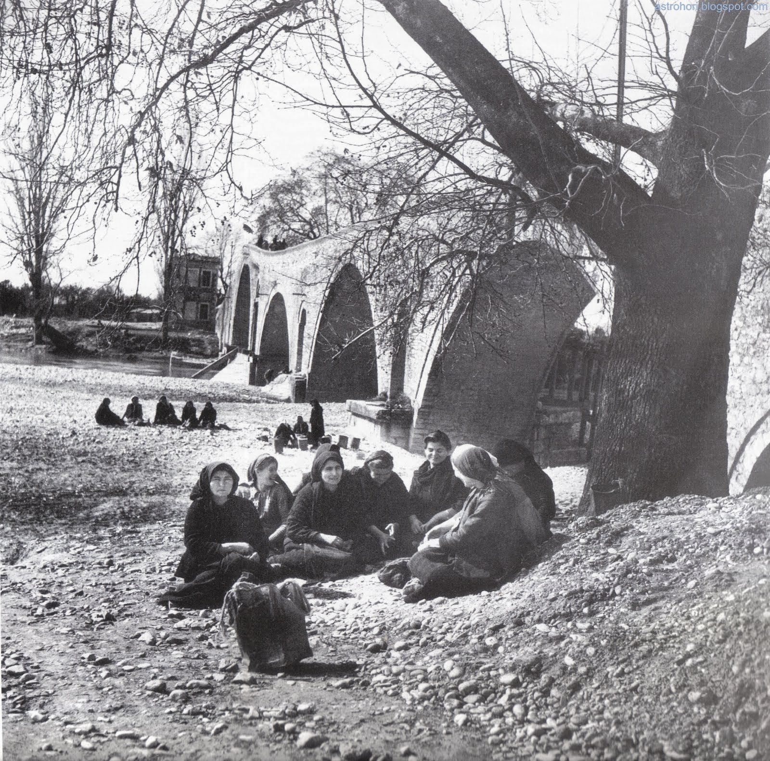

Slide 5
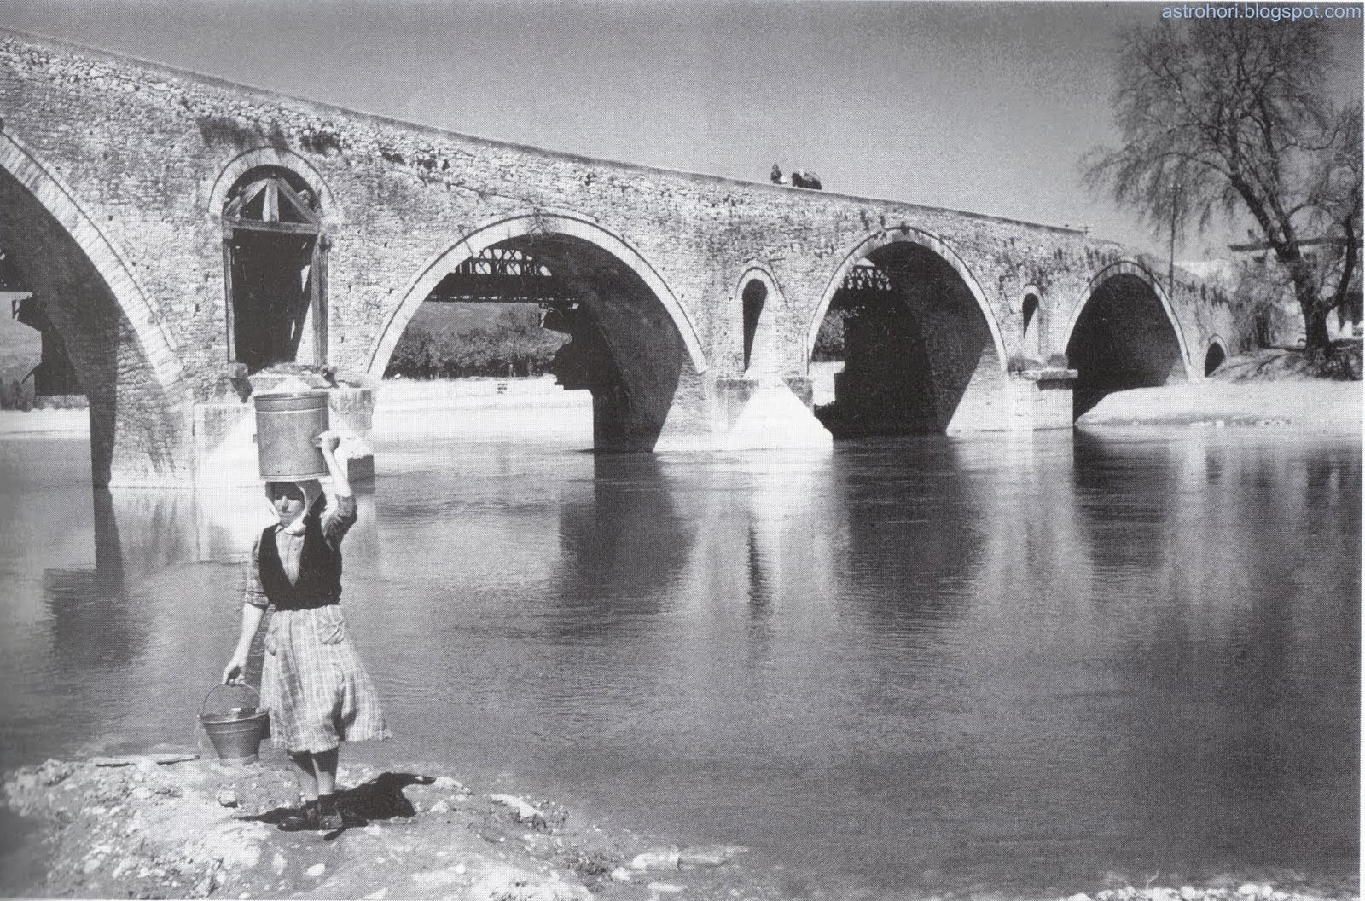

Slide 6
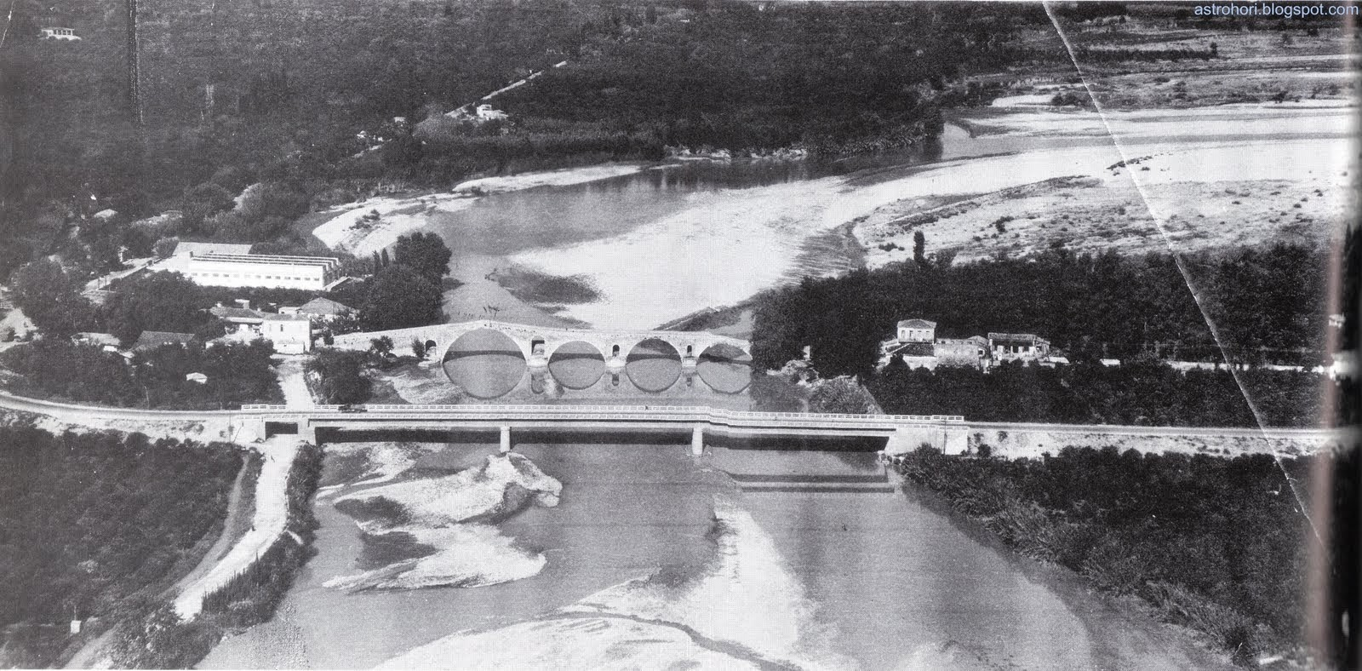

Slide 7
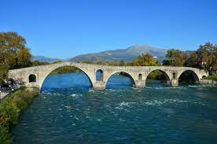
The Bridge of Arta is a stone bridge that crosses the Arachthos river in the west of the city of Arta in Greece. It has been rebuilt many times over the centuries, starting with Roman or perhaps older foundations; the current bridge is probably a 17th-century Ottoman construction.

Slide 8
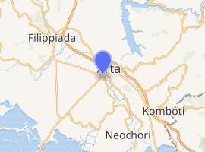
Arta Bridge
Coordinates | 39°09′06″N 20°58′29″ECoordinates: 39°09′06″N 20°58′29″E
Carries | Pedestrian (footbridge)
Crosses | Arachthos River
Locale | Arta, Greece
Owner | Hellenic Ministry of Culture and Sports
Characteristics
Material | Stone
Width | 40 metres (130 ft)
Height | 12 m (39 ft 4 in)
No. of spans | 4
Piers in water | 5
History
Construction end | 1612; 410 years ago

Slide 9
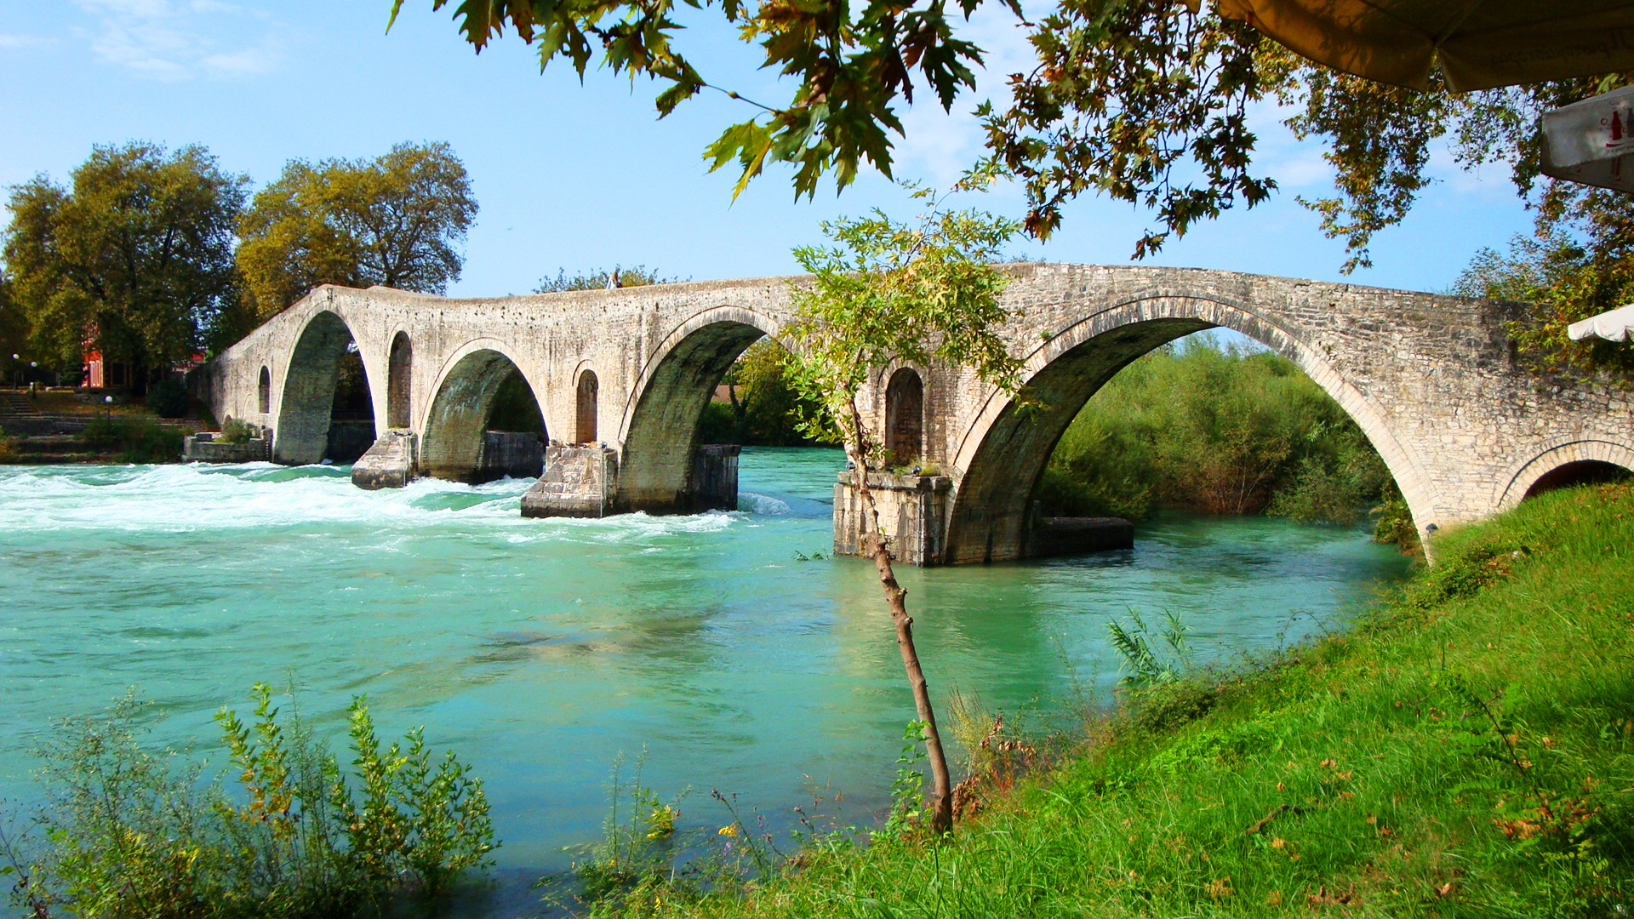

Slide 10
THE BRIDGE OF ARTA TODAY

Slide 11
References[edit] ^ Jump up to:ª ^{b} Leontis 1999
Sources[edit]
Artemis Leontis, "The Bridge between the Classical and the Balkan", The South Atlantic Quarterly 98:4:625-631 (1999) at MUSE On understanding the place of the Bridge of Arta in the literary landscape.
wikipedia

Slide 12
RAFAEL BAKOGIANNIS B3

