Slide 1
The Colosseum of Rome
The Colosseum Colosseo is an oval amphitheatre in the centre of the city of Rome, Italy, just east of the Roman Forum

Slide 2
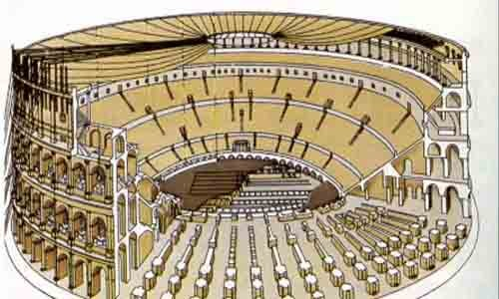
The history of the Colosseum
Flavian emperor Vespasian had this amphitheatre that could accommodate 65,000 spectators built in the year 72 CE. Construction of the Colosseum took eight years and was financed with plunder taken from Jerusalem. The Colosseum, also called the Amphitheatrum Flavium, was opened by emperor Titus with games and festivities that lasted 100 days and cost the lives of 5,000 animals. Emperor Domitian, Titus' successor, later expanded the amphitheatre with an extra storey and a number of spaces underneath the Colosseum. This made the Colosseum of Rome the largest amphitheatre in Roman history, and it is considered one of the seven wonders of the world.
Although the Colossus was preserved, much of the Domus Aurea was torn down. The lake was filled in and the land reused as the location for the new Flavian Amphitheatre. Gladiatorial schools and other support buildings were constructed nearby within the former grounds of the Domus Aurea. Vespasian's decision to build the Colosseum on the site of Nero's lake can be seen as a populist gesture of returning to the people an area of the city which Nero had appropriated for his own use. In contrast to many other amphitheatres, which were on the outskirts of a city, the Colosseum was constructed in the city centre, in effect, placing it both symbolically and precisely at the heart of Rome.

Slide 3
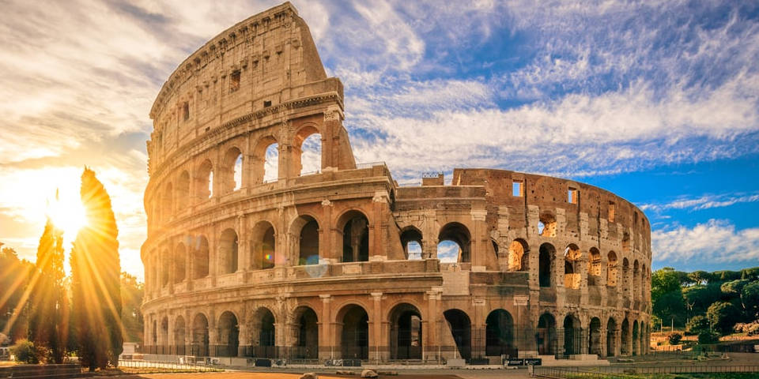
The use of the Colosseum
The main purpose of the Colosseum in Rome was to entertain the people – and thereby increase the popularity of the emperor – with gladiator battles, sometimes including wild animals, such as elephants and tigers. During intermissions, convicted criminals were often thrown to the wild animals. Gladiator battles were held in the afternoons. As Christianity become more important, the barbaric games were finally forbidden by emperor Honorius in 404 CE. The public lynching of a monk who tried to end a fight between two gladiators was the final straw. Until the year 523, only shows with wild animals were held there.

Slide 4
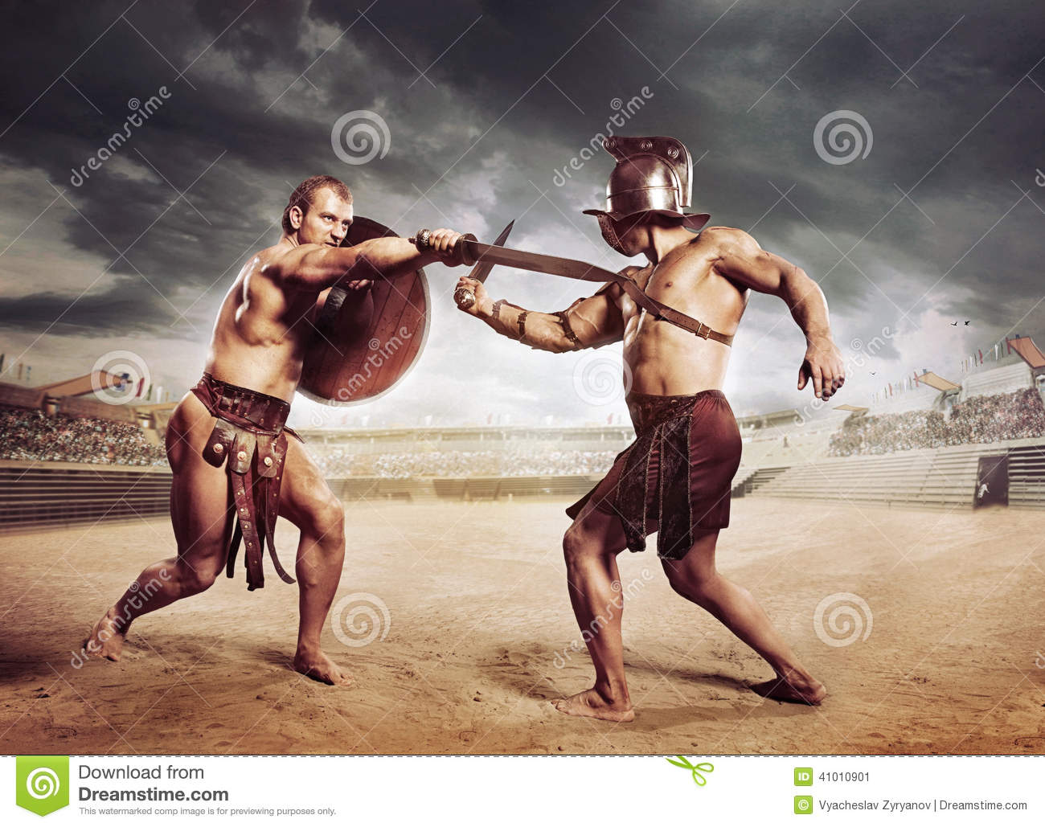
THE ARENA OF THE COLOSSEUM
The arena itself was 83 meters by 48 meters (272 ft by 157 ft / 280 by 163 Roman feet). It comprised a wooden floor covered by sand (the Latin word for sand is harena or arena), covering an elaborate underground structure called the hypogeum (literally meaning "underground"). The hypogeum was not part of the original construction but was ordered to be built by Emperor Domitian. Little now remains of the original arena floor, but the hypogeum is still clearly visible. It consisted of a two-level subterranean network of tunnels and cages beneath the arena where gladiators and animals were held before contests began. Eighty vertical shafts provided instant access to the arena for caged animals and scenery pieces concealed underneath; larger hinged platforms, called hegmata, provided access for elephants and the like. It was restructured on numerous occasions; at least twelve different phases of construction can be seen.

Slide 5
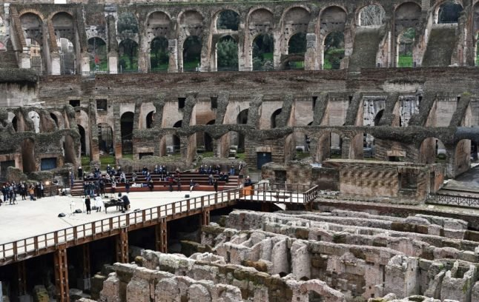
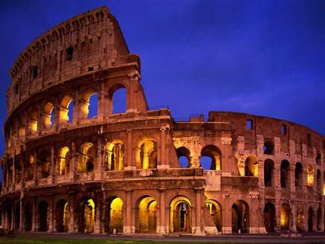
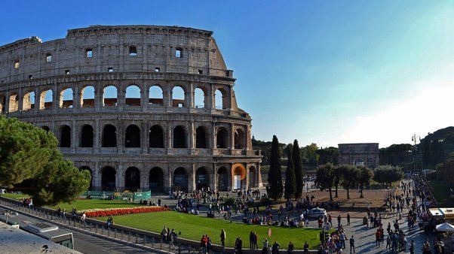
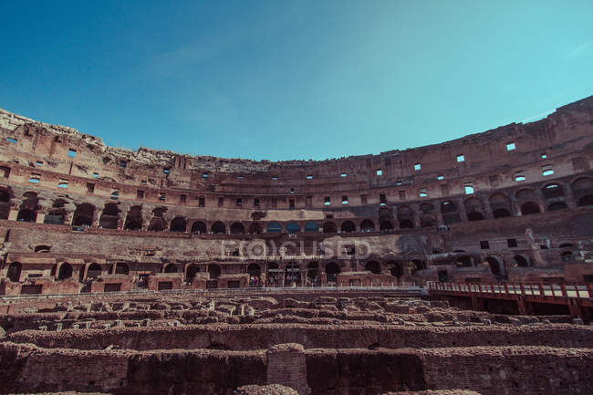
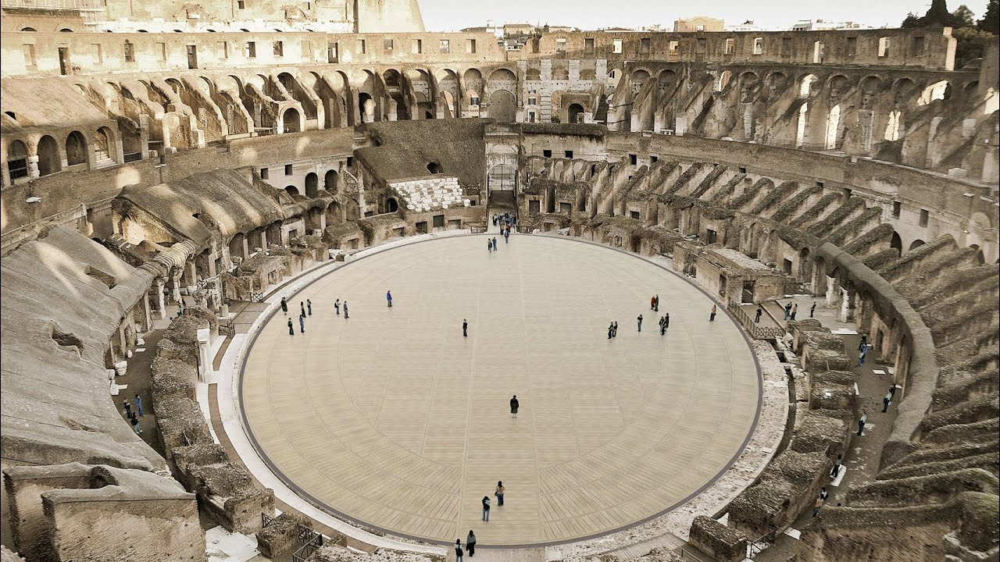
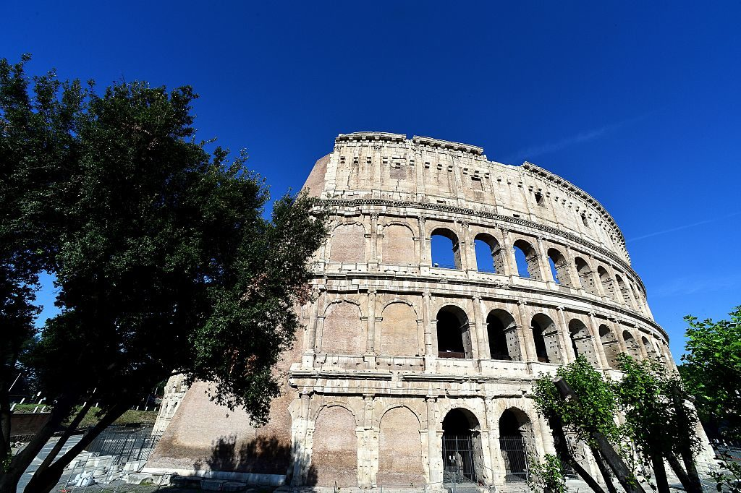
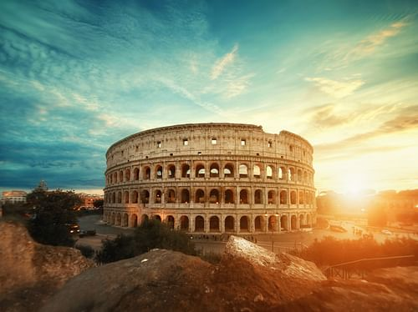
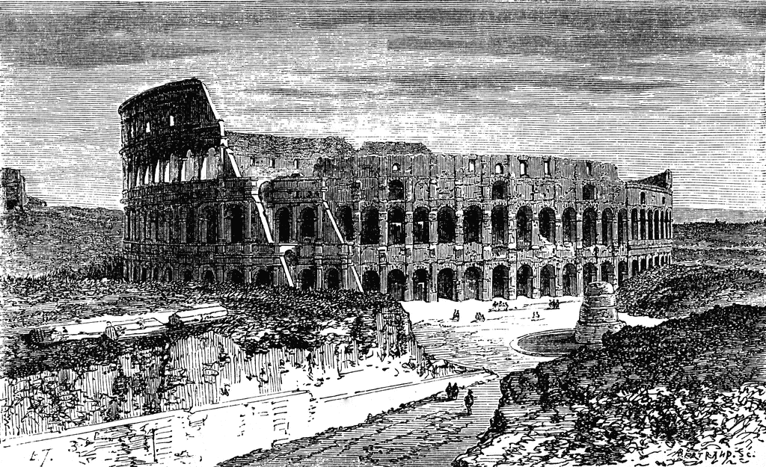
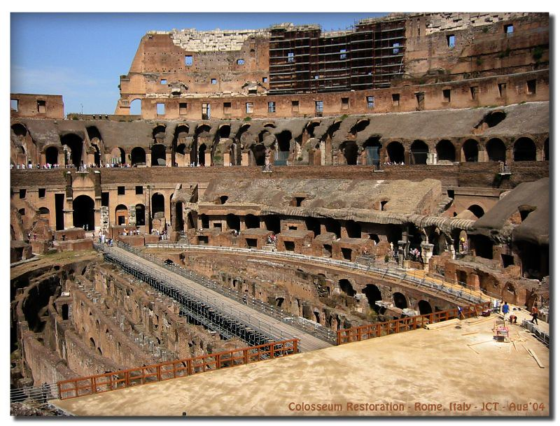

Slide 6
ΑΓΓΕΛΟΣ ΒΑΛΛΑΣ ΓΙΑΝΝΗΣ ΑΝΔΡΟΝΙΚΙΔΗΣ ΑΝΔΡΕΑΣ ΒΙΟΛΑΚΗΣ ΑΓΓΕΛΟΣ ΑΔΑΜΟΠΟΥΛΟΣ

