Slide 1
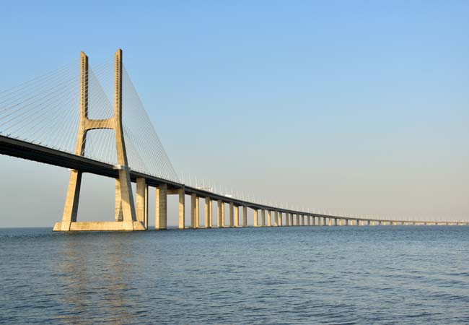
VASCO DA GAMA
BRIDGE

Slide 2
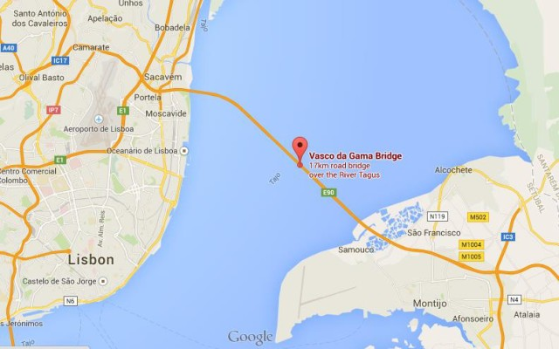
The Vasco da Gama Bridgeis a cable-stayed bridge flanked by viaducts that spans the Tagus River in Parque das Nações in Lisbon, the capital of Portugal.

Slide 3
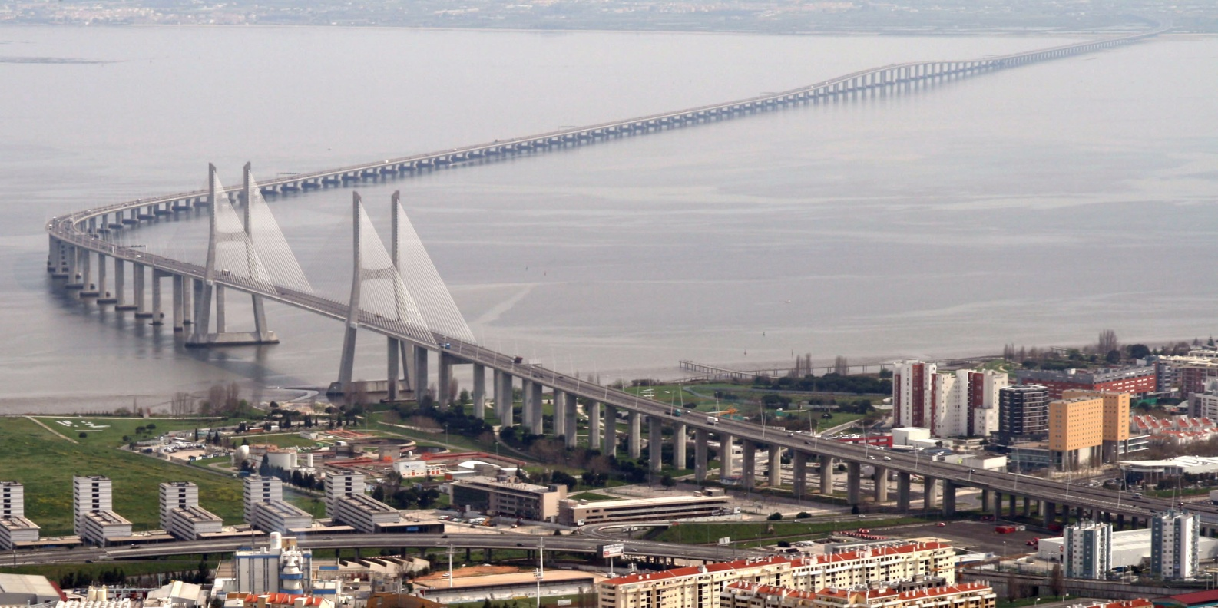
It is the second longest bridge in Europe, after the Crimean Bridge, and the longest one in the European Union, with it total length being 12,345 kilometres. It was built to alleviate the congestion on Lisbon’s 25 de Abril Bridge, and eliminate the need for traffic between the country’s northern and southern regions to pass through the capital city.

Slide 4
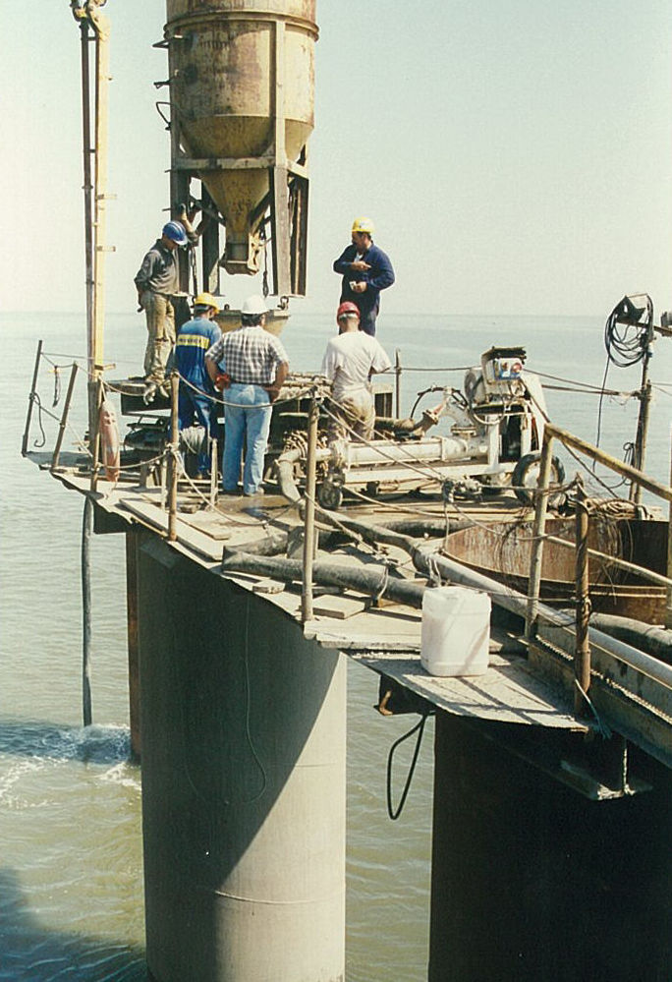
Construction began in February 1995. The bridge was opened to traffic on 29 March 1998, just in time for Expo 98, the World’s Fair that celebrated the 500th anniversary of the discovery by Vasco da Gama of the sea route from Europe to India.

Slide 5
The Vasco da Gama is one of two bridges that span the Tagus River in Lisbon.

Slide 6
Vasco da Gama weights around 2,200 tons and its height reaches 150 meters tall witch makes it one of the tallest constructions in Portugal. Every day approximately 52.000 vehicles cross the Vasco da Gama bridge.

Slide 7
This project was possible with the help of
Theodore Babalikis
Hlias Krounis
Labros Koutroumpilas

