Slide 1
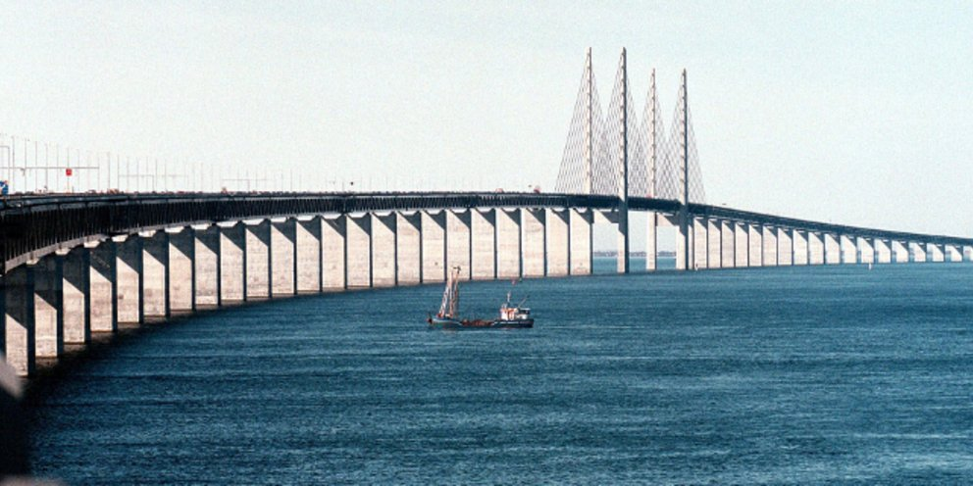
THE BRIDGE ØRESUND

Slide 2
INFORMATION ABOUT ORESUND
The Öresund or Øresund Bridge is a combined railway and motorway bridge across the Oresund strait between Denmark and Sweden. It is the longest in Europe with both roadway and railway combined in a single structure, running nearly 8 kilometers (5 miles) from the Swedish coast to the artificial island Peberholm in the middle of the strait. The crossing is completed by the 4-kilometre (2.5 mi) Drogden Tunnel from Peberholm to the Danish island of Amanger.

Slide 3
ECONOMY OF THE BRIDGE
The cost for the Øresund Connection, including motorway and railway connections on land, was DKK 30.1 billion (~€4.0 billion) according to the 2000 year price index, with the cost of the bridge expected in 2003 to be recouped by 2037. In 2006, Sweden began work on the Malmö City Tunnel, a SEK 9.45 billion connection with the bridge that was completed in December.
According to The Öresund Committee, the bridge has made a national economic gain of DKK 57 billion, or SEK 78 billion SEK (~€8.41 billion) on both sides of the strait by increased commuting and lower commuting expense. The gain is estimated to be SEK 6.5 billion per year but this could be increased to 7.7 billion by removing the three biggest obstacles to integration and mobility, the two largest being that non-EU nationals in Sweden are not allowed to work in Denmark and that many professional qualifications and merits are not mutually recognised.2010.

Slide 4
IT΄S HISTORY
Construction began in 1995, with the bridge opening to traffic on 1 July 2000. The bridge received the 2002 IABS .The idea was dropped during World War II, but picked up again thereafter and studied in significant detail in various Danish-Swedish government commissions through the 1950s and 1960s.^{[5]} However, disagreement existed regarding the placement and exact form of the link, with some arguing for a link at the narrowest point of the sound at Helsingør–Helsingborg, further north of Copenhagen, and some arguing for a more direct link from Copenhagen to Malmö. Additionally, some regional and local interests argued that other bridge and road projects, notably the then-unbuilt Great Belt Fixed Link, should take priority.^{[5]} The governments of Denmark and Sweden eventually signed an agreement to build a fixed link in 1973.^{[7]} It would have comprised a bridge between Malmö and Saltholm, with a tunnel linking Saltholm to Copenhagen, and would have been accompanied by a second rail tunnel across the Øresund between Helsingør and Helsingborg.^{[8]}
However, that project was cancelled in 1978 due to the economic situation,^{[9]} and growing environmental concerns.^{[10]} As the economic situation improved in the 1980s, interest continued and the governments signed a new agreement in 1991.

Slide 5
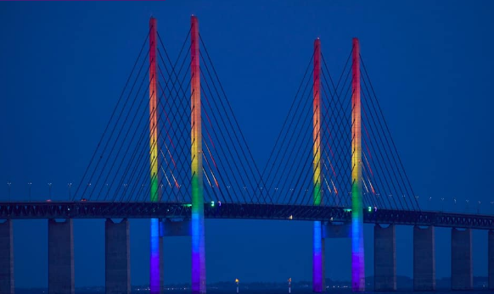
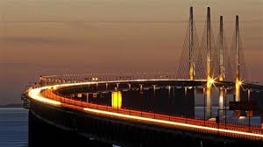
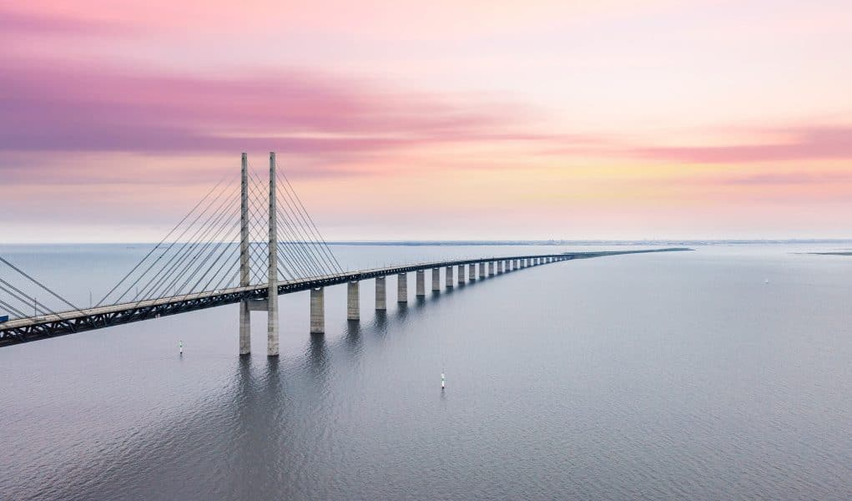
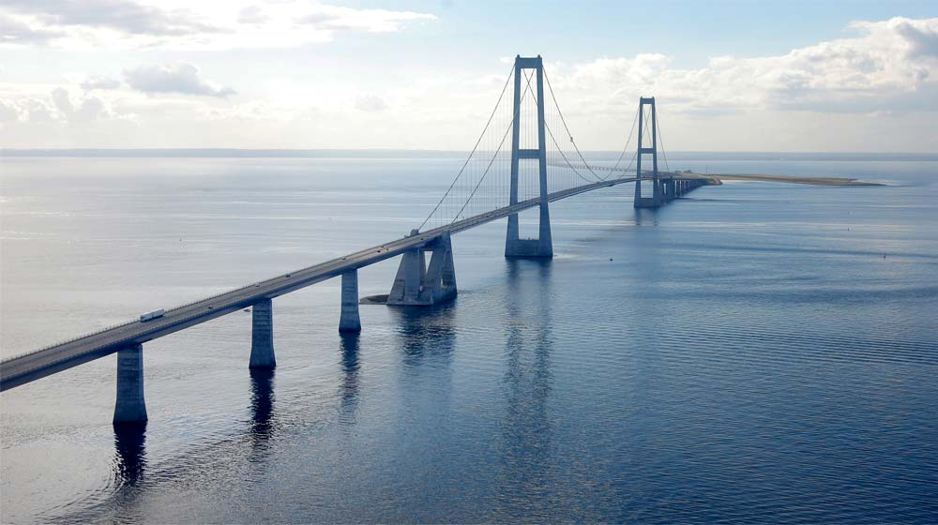

Slide 6
QUESTIONS
The Öresund or Øresund Bridge is a combined railway and motorway bridge across the Oresund strait between…………… and …………….. .
The crossing is completed by the 4-kilometre (2.5 mi) ………… …………… from ………….. to the Danish island of Amanger.
According to The Öresund Committee, the bridge has made a national economic gain of DKK …………….. , or SEK …………….. .
Construction began in………… , , with the bridge opening to traffic on ……………………………………… .
However, that project was cancelled in …………… due to the economic situation.

Slide 7
THE END
THANKS FOR YOUR TIME WE HOPE YOU ENJOY IT!!
FILIPPOS FYLAKTOS AGGELOS TSAKONAS MARIOS PAPAMICHAIL PANAGIOTHS TSITINIS SERGIO SOULA

