Slide 1
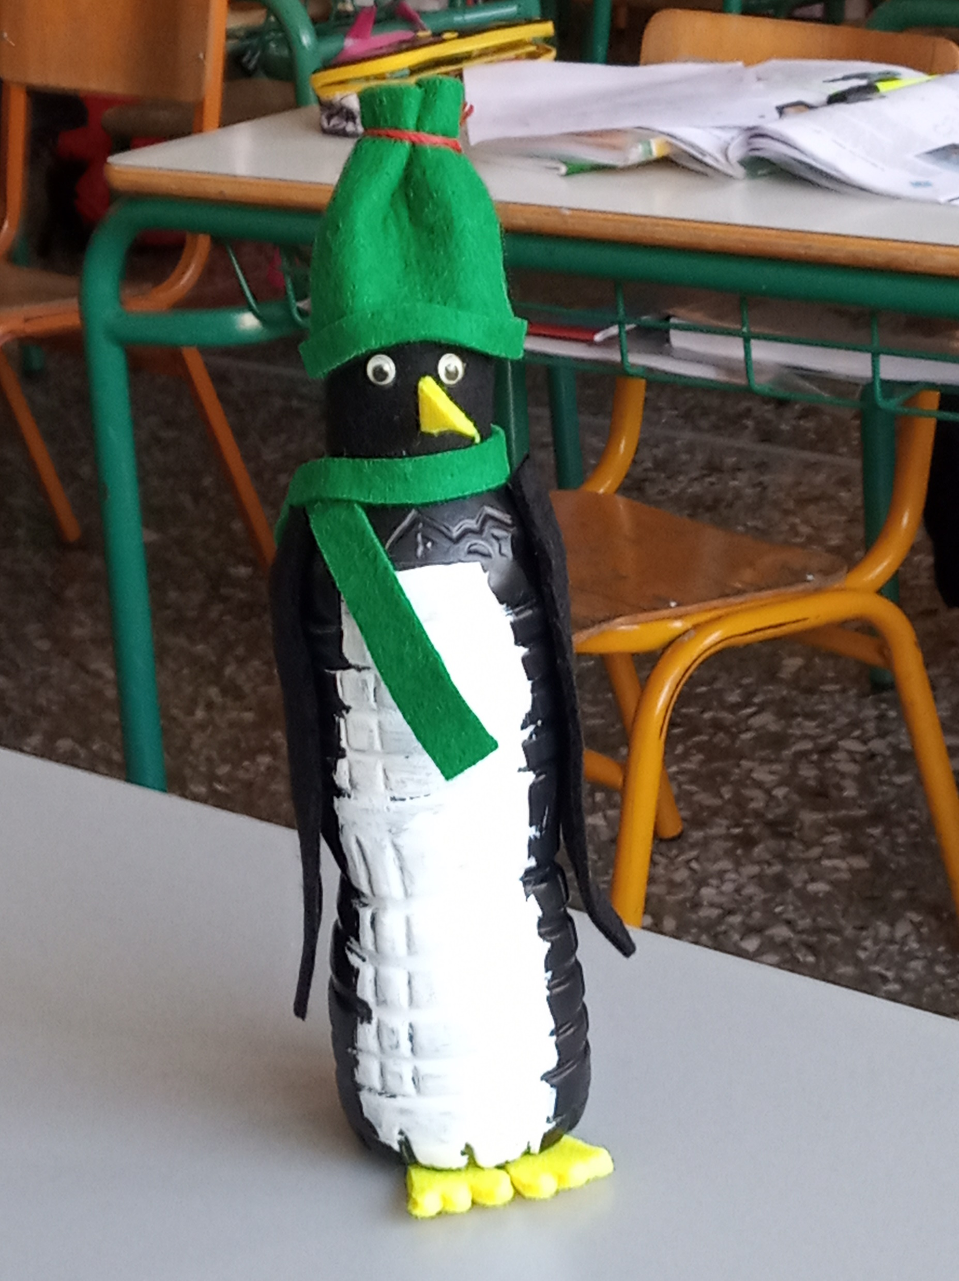
Penguin craft
By E1 class – 7th primary school of Ilioupolis

Slide 2
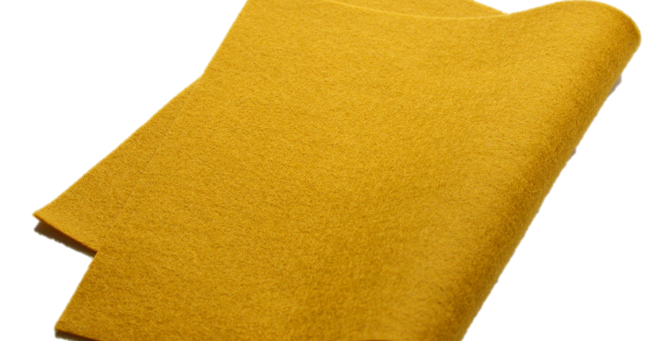
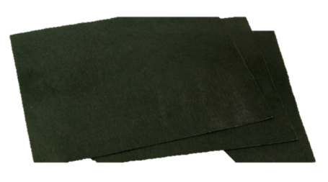
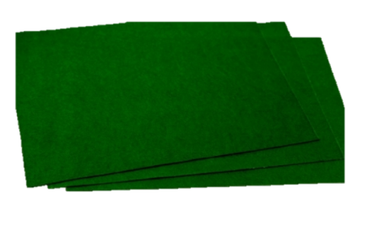
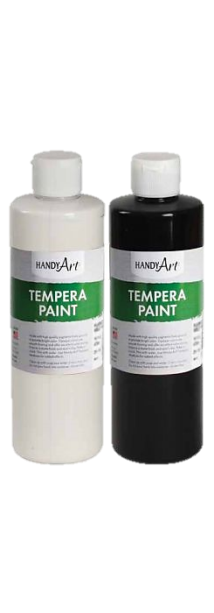
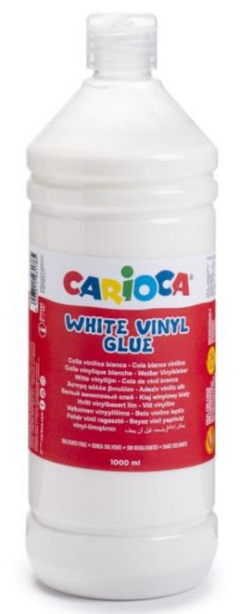
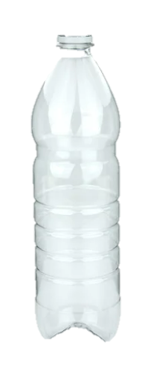
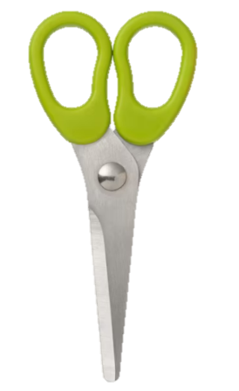
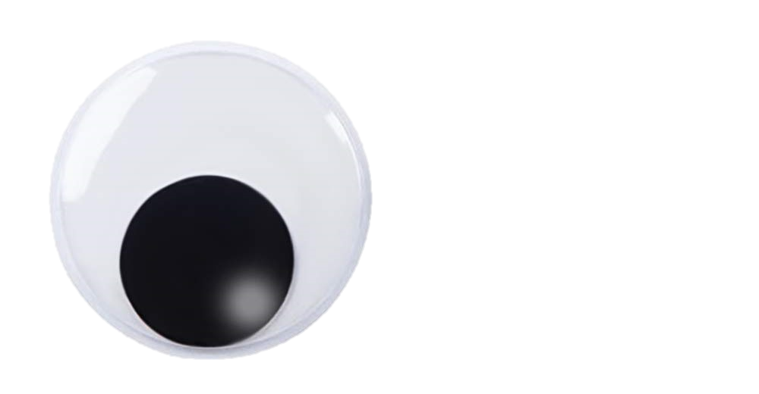
Materials
white glue
an empty plastic bottle of water
black and white paint
felt: green, black, and yellow color
small Googly eyes
paintbrush
scissors

Slide 3
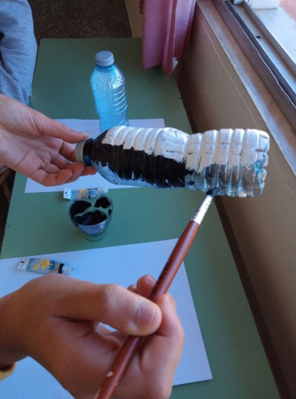
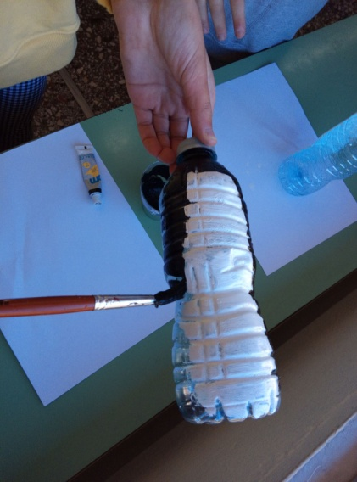
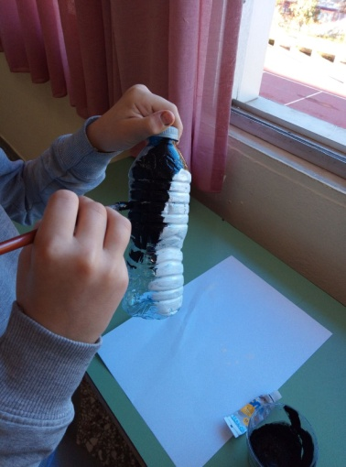
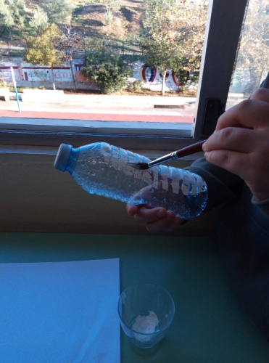
Instructions
Step 1
Paint 2/3 of the bottle with black paint.
Paint 1/3 of the bottle with white paint.

Slide 4
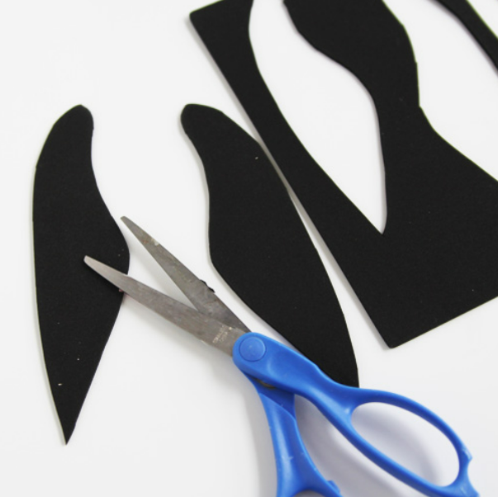
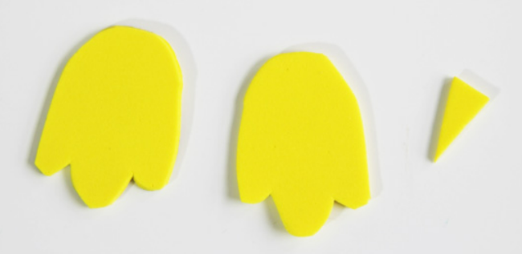
instructions
Step 2
Cut the flippers out of black felt, and the beak and the webbed feet out of yellow felt.

Slide 5
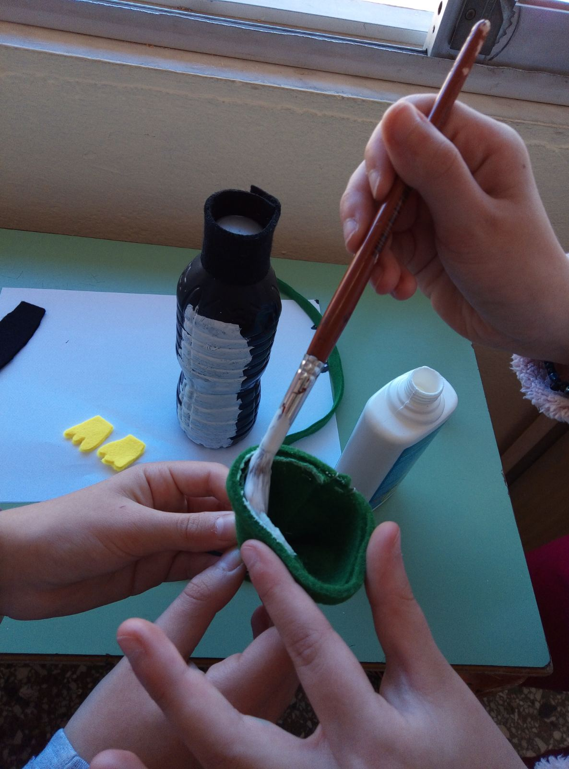
instructions
Step 3
Cut a piece out of black felt and wrap it around the bottle cap and stick it.
That’s the penguin’s head.

Slide 6
instructions
Step 4
Cut a piece out of the green felt.
Roll it up and tie a piece of string to the top.
Stick it on the head.
This is the woolen cap.

Slide 7
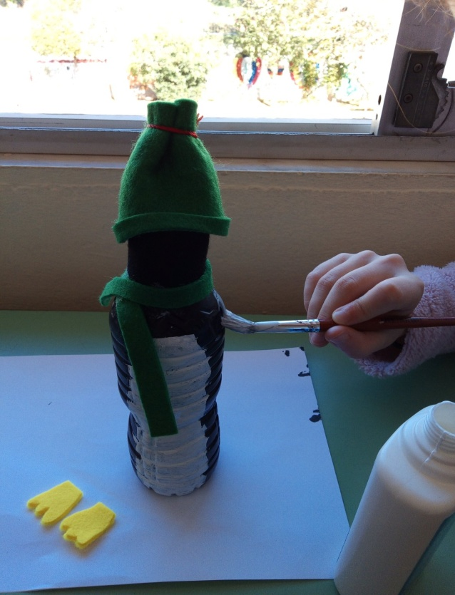
instructions
Step 5
Cut a piece out of the green felt.
Wrap it around the neck and stick it.
This is the scarf.

Slide 8
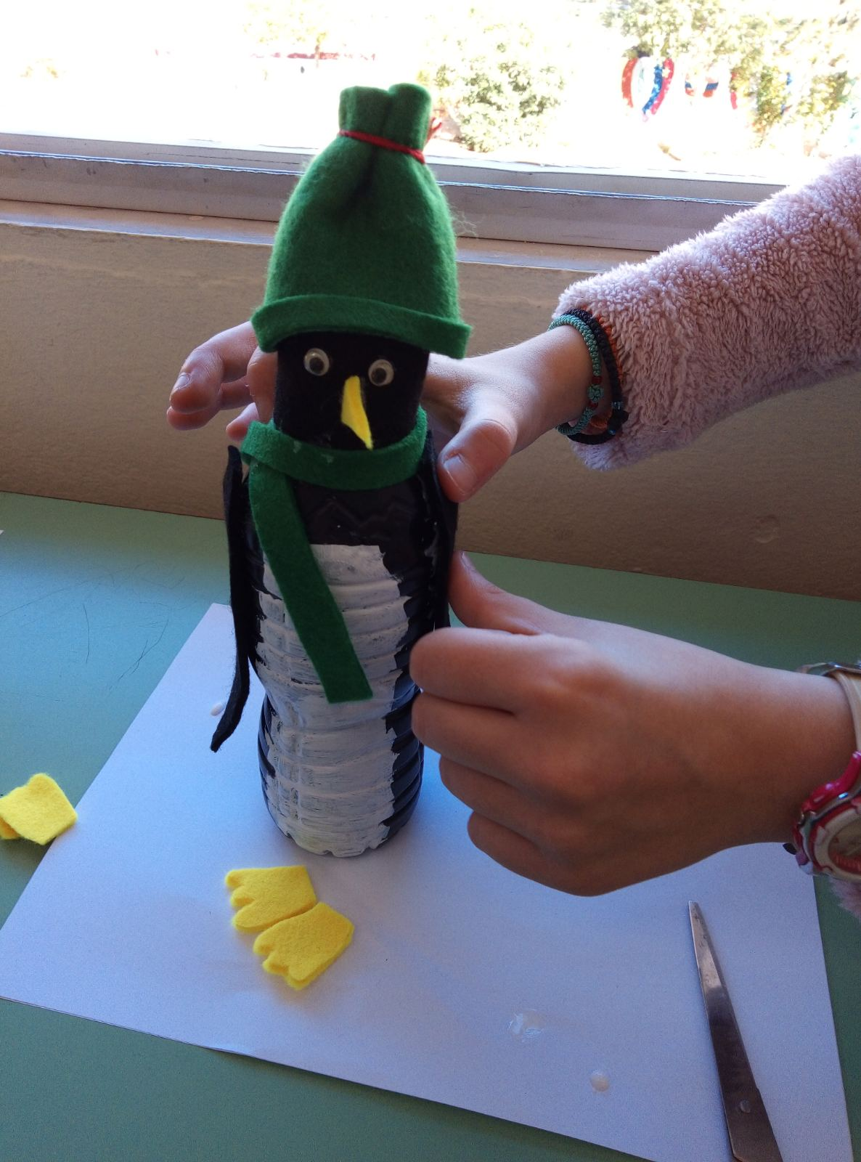
instructions
Step 6
Stick the beak, the googly eyes, the webbed feet, and the flippers.

Slide 9
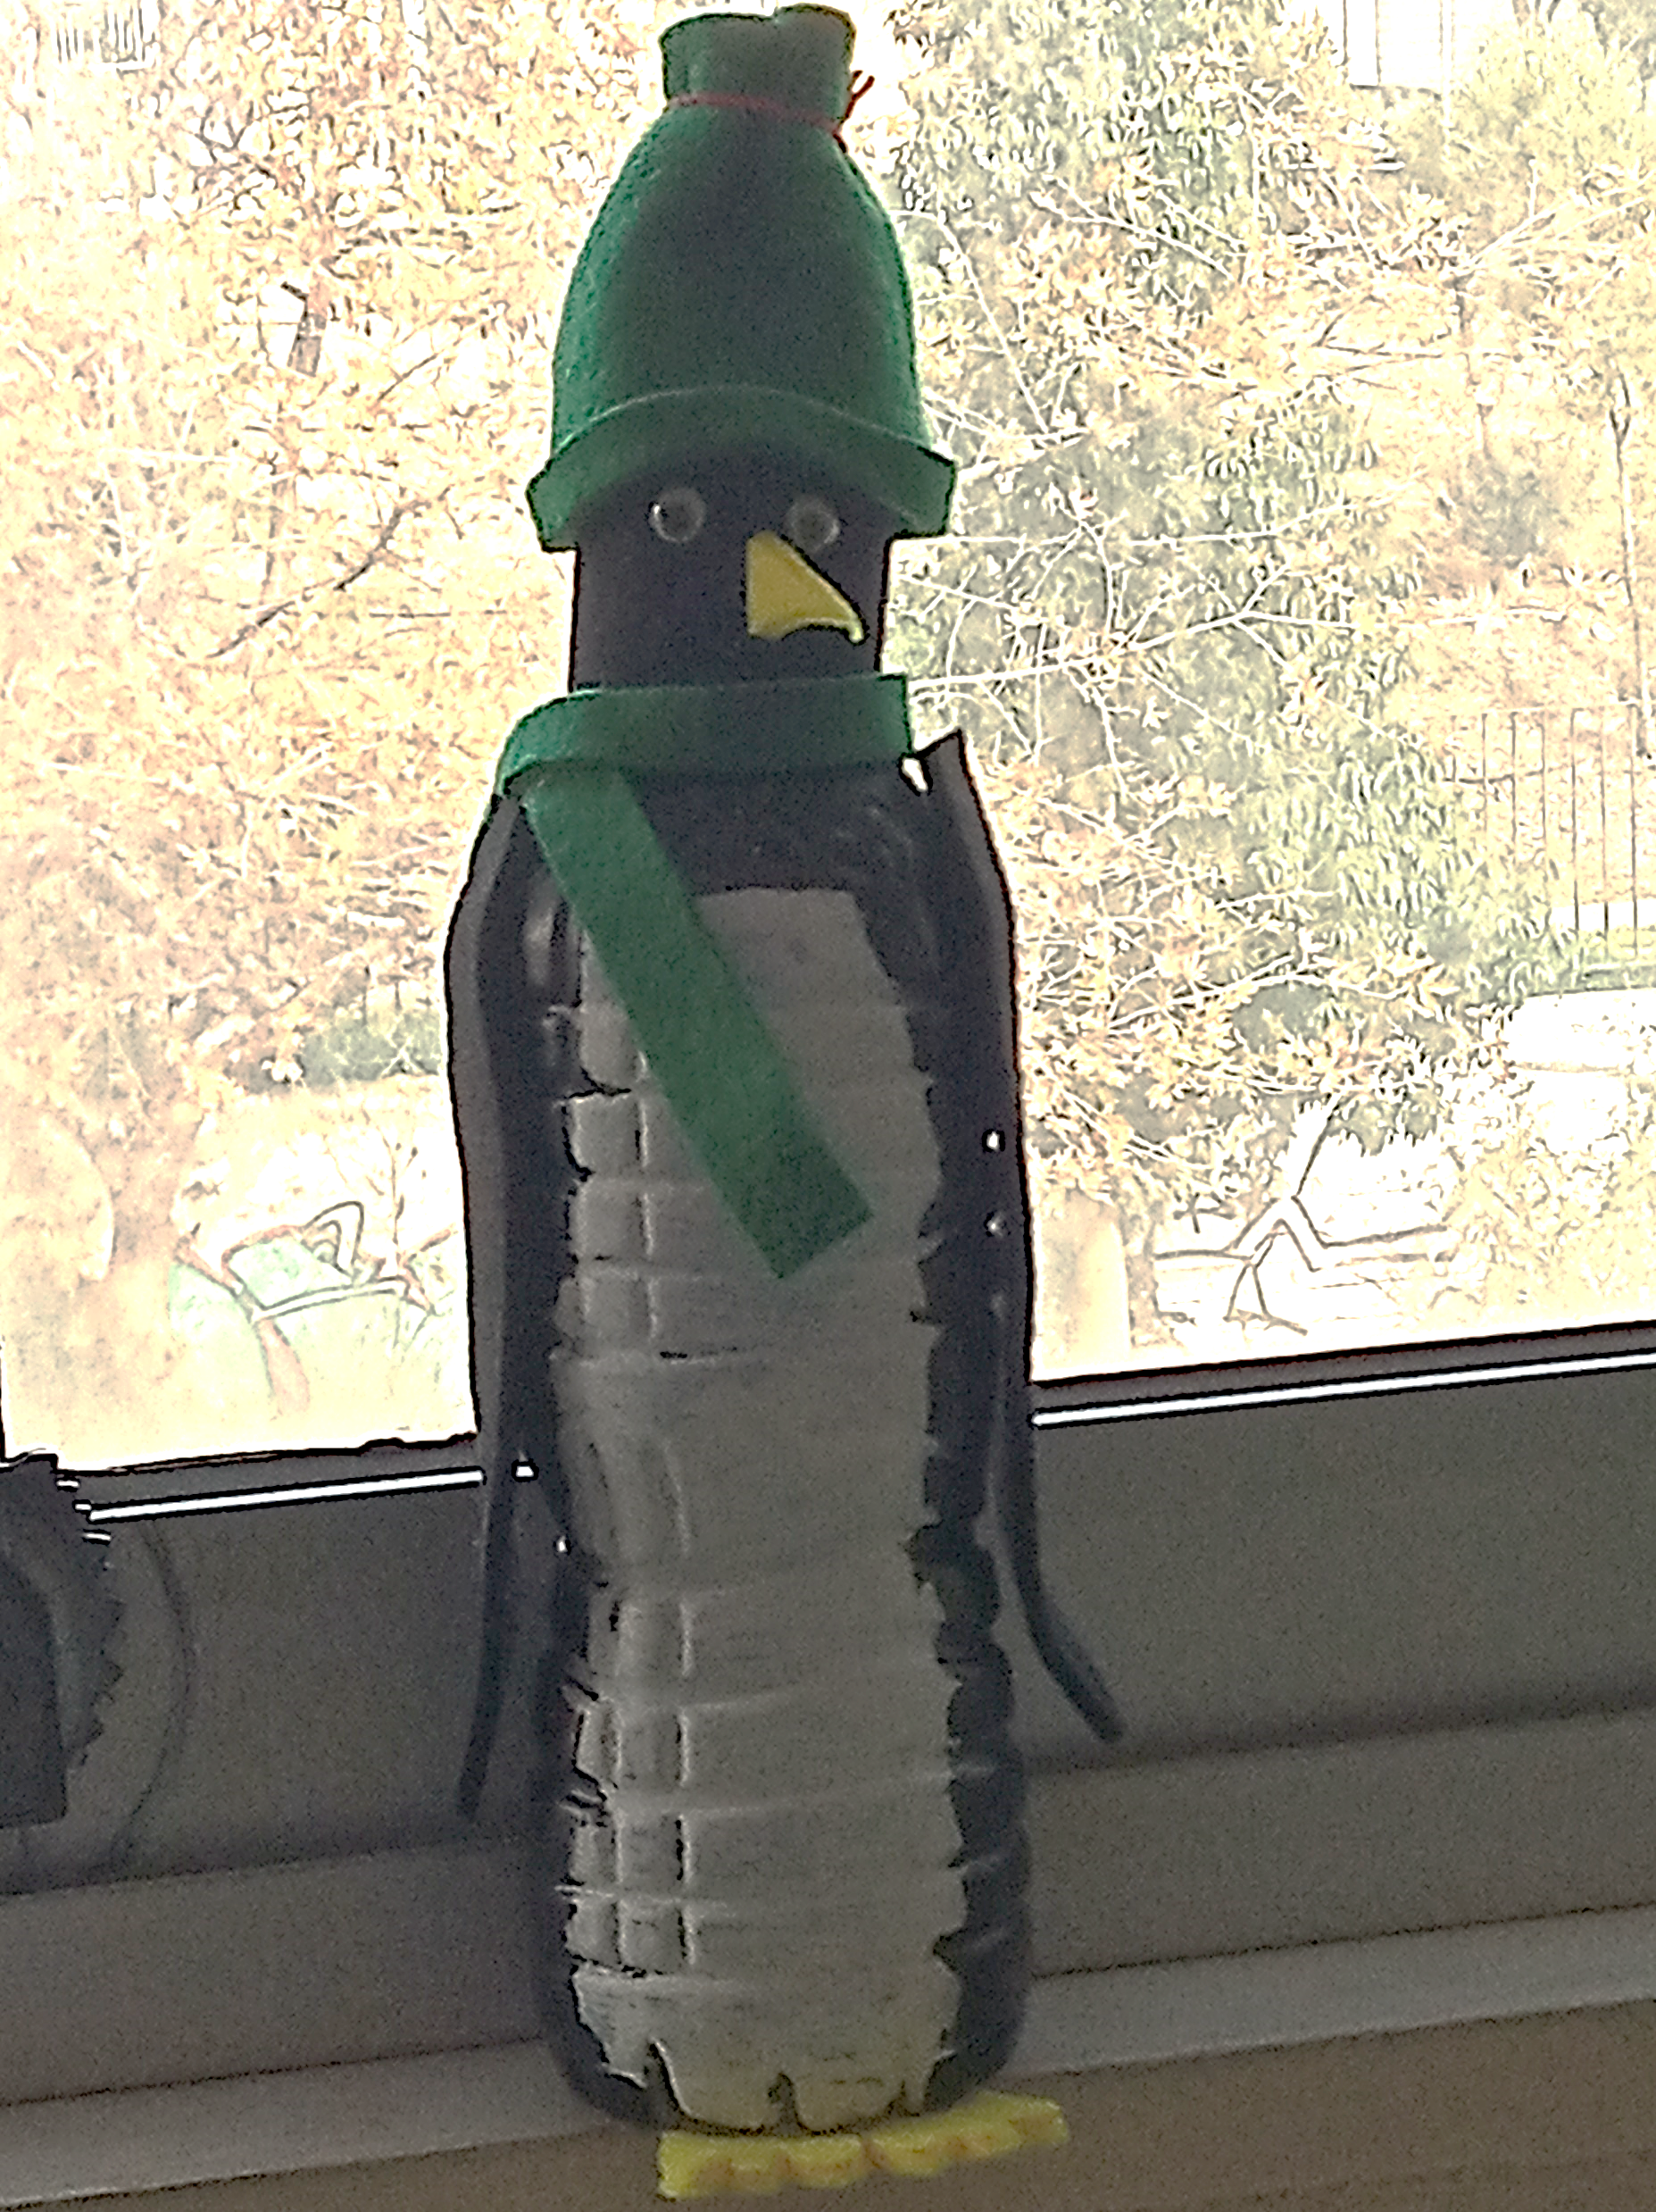
ready

